Slide 1
Cisco College 2024 spring faculty/staff convocation January 2, 2024
The mission of Cisco College is to provide quality, affordable, educational opportunities to meet the diverse academic, technical and career needs of the students and communities we serve.

Slide 2
AGENDA
WELCOME BACK!
NEW EMPLOYEE INTRODUCTION
COLLEGE UPDATE
FACULTY & STAFF UPDATES
INFORMATION TECHNOLOGY UPDATE

Slide 3
Cisco College Welcomes New Employees to the Wrangler Family and Team! (Hired Since September 2023)
Name | Start Date | Position
Taylor Alexander | 9/5/2023 | Director of Clinical Education, Nursing
Tracey Cunningham | 9/5/2023 | Simulation Coordinator, Nursing
Robert Miller | 9/11/2023 | Level 1 Technical Specialist, IT
Michaela Bradford | 9/11/2023 | Allied Health Counselor
Karisa Kinard | 9/21/2023 | Custodian Abilene
Brian Harriman | 9/26/2023 | Accounts Payable Specialist
Rebecca Barnett | 10/23/2023 | VN Remediation Specialist
Amy Allen | 10/23/2023 | Dual Credit Specialist
Lori Grubbs | 11/20/2023 | Dean of Enrollment Services
Felicia Barron | 1/1/2024 | Biology Professor
Quida Hart | 1/1/2024 | VN Retention Specialist
Daniel Stanson | 1/1/2024 | Automotive Professor
Jessica Stovall | 1/1/2024 | Cosmetology Instructor
Bonnie Coxe | 1/1/2024 | Respiratory Care Professor
Margaret Viertel | 1/1/2024 | Mathematics/Science Professor
Spencer Woody | 10/28/4670 | Director of Nursing

Slide 4
Cisco College celebrates faculty & staff service: 5, 10, & 20 year awards
5 Years | 10 Years | 20 Years
Zachary Brown | Kathy Wright | David White
Audrey Buchanan | Linda Spetter | George Gallegos
Bryan Cottrell | Karen Leath | Manny Martinez
Rachel Ritchie | William Hagood | Audra Taylor
Jenna Wood | Kimberly Torres | Amy Shott
Cristina Dita | Brian Sigler | Sarah Wise
Laurie Kincannon
Colton Wedeking
Terry Jarrett
Mark Jones
Kyle Smith
Joy Raines
Recognition ceremony will be held in May for all awards each year.

Slide 5
College update
I.

Slide 6
College update
I.

Slide 7
Faculty & Staff updates & notifications

Slide 8
Faculty & Staff updates & notifications
Mandatory Purchasing & Payments Training,
Jan. 3 – 10am - Cisco Campus, Harrell 2nd floor
Jan. 4 – 10am – Abilene Campus, Room 236
All Pcard holders and approvers are required to attend, including chairs, directors, supervisors, department heads, and coaches. Failure to attend will result in cancellation of your Pcard.
All employees are encouraged to attend. If you purchase things, pay or receive bills for your department or program, or submit reimbursement requests, please attend.

Slide 9
Faculty & Staff updates & notifications
Vision 2023 Strategic Plan Survey coming to you!
Cognito form sent via email from President’s office.
Looking to gather feedback from all areas and levels on goals, strategies, & outcomes itemized in Vision 2023.
Answer any and all you can. Provide suggestions if can.
From your view & area, what have we achieved or what do we still need to do?

Slide 10
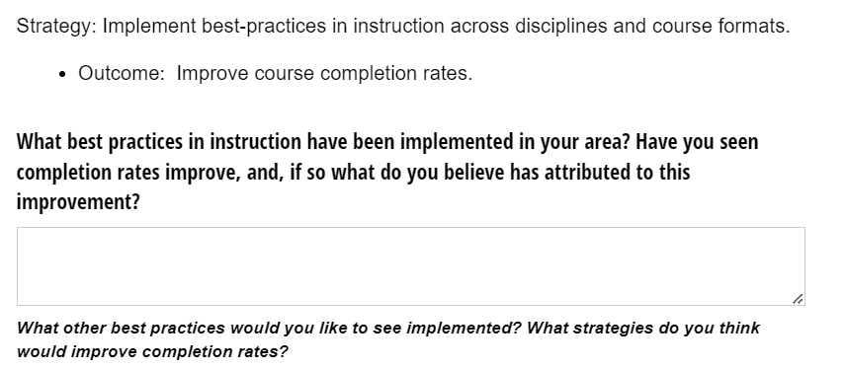
Strategic Plan Survey Example

Slide 11
Faculty & Staff updates & notifications
Spring Meeting Schedule
Bi-Monthly Meetings
AEC Faculty Meetings:
2nd Wednesday at 2pm in Feb (on campus) & April (Zoom).
Cisco Faculty Meetings:
2nd Tuesday at 2pm in Feb (on campus) & April (Zoom).
Academic Leadership Council:
2nd Wednesday at 2pm in Jan, March, & May. – Zoom
Admin, Deans, Directors, Chairs

Slide 12
Faculty & Staff updates & notifications
Data Day – a new, annual, all-college initiative starting Spring 2024!
Save the date: Friday, March 22, 2024
Cisco Campus – all faculty & staff
Regularly scheduled day to get our IE stuff done!
Strategic Plan & Institutional Goals for success progress & feedback.
Cross-departmental group discussions.
Program / division meetings for IE plan progress & discussion.
Required in-service & counts for professional development!
More info at Jan Academic Leadership Council and February faculty meetings.

Slide 13
Faculty & Staff updates & notifications: Distance ED UPDATES
Replacing Unicheck
Feedback by 1/29
Spring Professional Development Calendar
Giving Effective Feedback
February 29th @3pm
Faculty Resources
Tutoring
Regular & Substantive Interaction
Checklist
Course Template

Slide 14
Canvas Commons

Slide 16
Bring on Spring 2024! Let’s do this Wranglers!
Celebrating Milestones and Preparing for the Road Ahead

