Slide 9
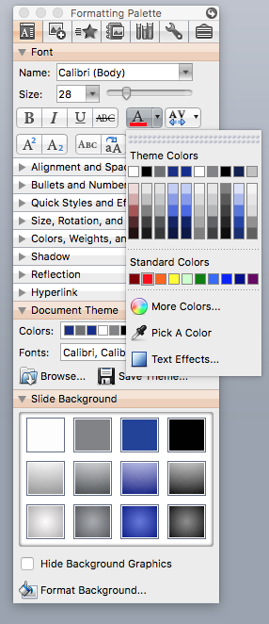
COLOR PALLETE
For text, shapes, and charts, select from the Theme Colors

