Slide 1
Cisco College 2022 fall faculty/staff convocation AUGUST 17, 2022
The mission of Cisco College is to provide quality, affordable, educational opportunities to meet the diverse academic, technical and career needs of the students and communities we serve.

Slide 2
AGENDA
WELCOME
SPONSORS AND PARTNERS DRAWINGS
CELEBRATING YEARS OF SERVICE AT CISCO COLLEGE
NEW EMPLOYEE INTRODUCTIONS
COLLEGE UPDATE
QUALITY ENHANCEMENT PLAN (QEP) UPDATE
DISTANCE EDUCATION UPDATE
INFORMATION TECHNOLOGY UPDATE

Slide 3
WELCOME cisco college wrangler family and team!
Good Morning!
Productive Summer – Thank you to all involved in the numerous projects across both campuses.
Together we have many accomplishments to celebrate.

Slide 4
Cisco College Welcomes New Employees to the Wrangler Family and Team!
Millwood | Lynn | 1/1/22 | Move from Adjunct to Full-time Math/Geology
Flinn | Savannah | 1/1/22 | Assistant Softball Coach
O'Mera | John | 2/8/22 | Head Football Coach
Ankner | Sarah Frances | 3/1/22 | Business Services Bookkeeper
Kimball | Brock | 3/8/22 | Head Basketball Coach
Torres | Alexandria | 3/28/22 | Residence Hall Supervisor/Assistant Volleyball Coach
Thomas | Mathis | 4/1/22 | Assistant Football Coach/Dorm Supervisor
Hutchens | Nikaela | 4/1/22 | Vocational Nursing Adjunct
Bishop | Rachel | 5/9/22 | Pharmacy Tech Professor
Woody | Spencer | 5/9/22 | Vocational Nursing Professor
Boudreau | Deborah | 6/1/22 | Admin Assist Dean Of Workforce and Economic Dev.
Bryant | Rhonda | 6/1/22 | Full Time Cosmotology Instructor
Dick | Aspen | 6/1/22 | Full time Academic Support Specialist
Elkins | Stacey | 6/1/22 | Director of Wrangler Belles Dance/Drill Team
Robinson | Dominic | 6/20/22 | Assistant Baseball Coach/Dorm Supervisor
Wilson | Michelle | 7/1/22 | Director of Clinical Education (DCE) Respiratory
Brookman | Misty | 7/5/22 | Coordinator of Student Recruitment
Rowzee | Steven | 7/5/22 | Assistant Football /Dorm Supervisor
Messado-Moten | Anthony | 7/14/22 | Assistant Football Coach/Dorm Supervisor Presidents Hall
Carrillo | Odalis | 8/3/22 | Assistant Basketball Coach/Dorm Supervisor
Sippio | Robert | 8/1/22 | Assistant Football Coach FT Offensive Coordinator
Boen | Jackson | 9/1/22 | Business Professor
Frizzell | Zachary | 9/1/22 | Director of Performing Arts
Little | Meredith | 9/1/22 | History/Government Professor
Wood | Jenna | 9/1/22 | Cheer Coach

Slide 5
Cisco College Service pins
2021-2022 Cisco College Service Pins
5 Year Pins | 10 Year Pins | 20 Year Pins | 25 Year Pins | 35 Year Pins
Tara Bontke | James Berry | Vicki Carney | Bud Henson | Cindy Brookey
Trinity McCandless | John Caraway | Amy Cohen
Mary McKendree | Pamela Dorn
Teresa Morris | Mark Farrar
Kathryn New | Elsie Jackson
Sarah Pitts | Justin Plunk-Ceniceros
Judy Posey
Joel Prickett
Tracy Talley
Katie Thompson
Kristi Timerson
Notes:
Welcome New Faculty/Staff to the Cisco College Wrangler Family! Please stand when I call your name.

Slide 6
PROGRESS /IMPROVEMENTS ACROSS BOTH CAMPUSES
Priority - Significant upgrades in classroom technology
Media Creation Center (MC2) (AEC 120) support faculty and staff in creating program promotional videos.
Abilene Campus – Business Office remodel (Create a more welcoming environment for students)
Significant updates to HVAC systems on both campuses – improving system operating efficiencies, air quality in buildings, and lowering long term M&O costs at the college.

Slide 7
PROGRESS /IMPROVEMENTS ACROSS BOTH CAMPUSES
Improvements in classrooms and labs – minor renovations.
Change out of old chalk boards to new glass boards
Furniture replacement - Classroom and campus lobbies
Audio/Visual Upgrades across both campuses

Slide 8
College Priorities
Enrollment and Student Success (Completion Rates)
- Strategic Enrollment Management (SEM) and Retention Plan (Team Effort)
Enterprise Resource Planning (ERP) – replace legacy system POISE (reliability long term, streamline business operations, cybersecurity, improve services to students, faculty, staff, reports data in real time and so simple that I can run them.
Strengthen partnerships across all areas (School Districts, Business/Industries, Four-Year Universities, Foundations, etc.)

Slide 9
College priorities
Continue responding to the growing skills gap across all sectors of the workforce.
- No. 1 threat to businesses (fast track programs to keep pace with the workforce demands in the region.
Grant Research, Development, and Management
Abilene Maintenance Tax (Feasibility Study)
88th Legislative Session (Ensuring Cisco College is Represented)

Slide 10
College Priorities
Program Enhancements and New Program Development
Academic Program Pathways
Excellence in all Student Service Areas
Strategic Planning and Institutional Effectiveness
Quality Enhancement Plan (QEP)
Fiscal Management and Planning for Future Growth
Improved Awareness of Programs and Positive Impact on the Region (Economic Impact Study)

Slide 11
Legislative Session Priorities
Session begins on January 10, 2023
Capital Construction Assistance Projects (Buildings & Equipment)
Dual Credit – Establish a statewide funding strategy that carefully considers the unique needs of rural community colleges.
Rural College Funding

Slide 12
QEP: Making Connections

Slide 13
Thank you, QEP GROUP A!
Nirmala Chandrasekharan
Bill Hagood
Bea Jackson
Beth Jackson
David Jackson
Staci Shupe
Kyle Smith
Terra Snyder
Brandi Terry

Slide 14
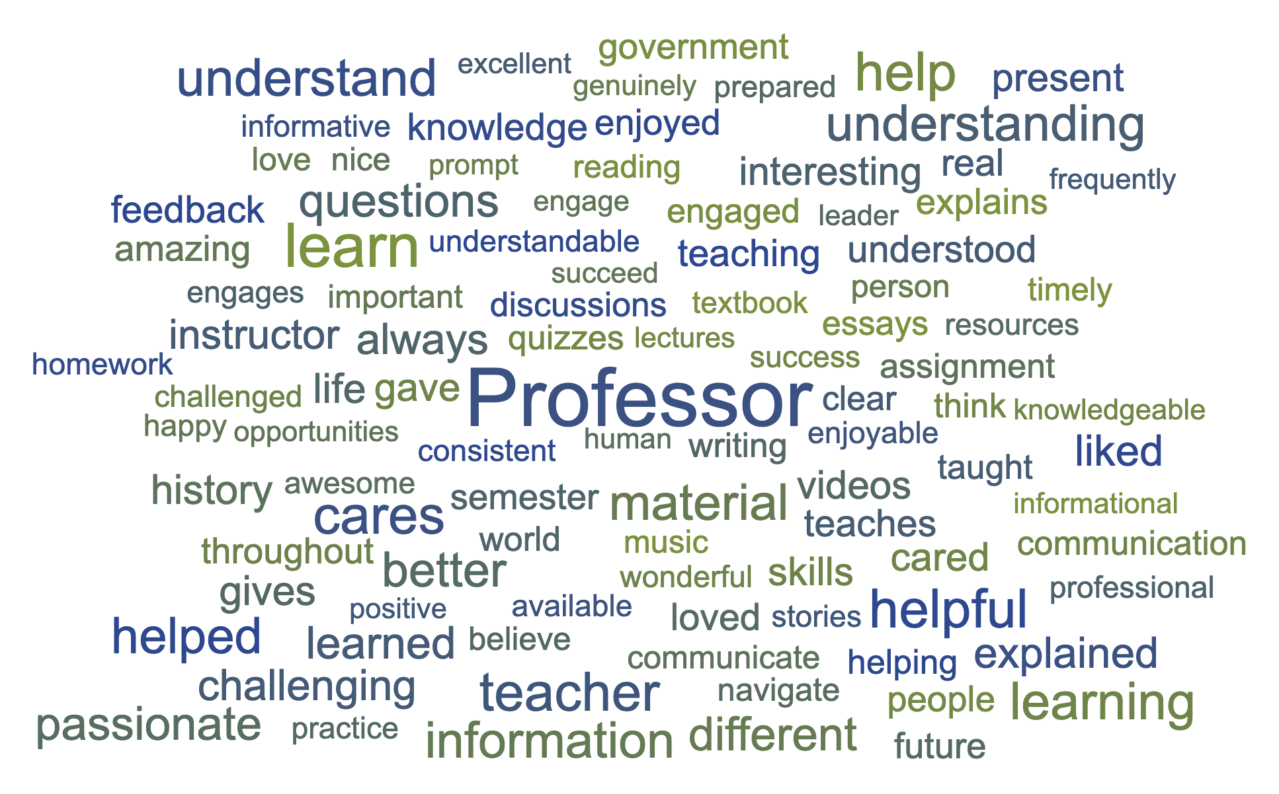
CELEBRATE!

Slide 15
Professional Development
Go2Knowledge
Online Learning Consortium
1:1 Gradebook Review & Training
QEP: Making Connections

Slide 16
RSI
Introduction Session:
Thursday, August 18th at 10AM via Zoom

Slide 17
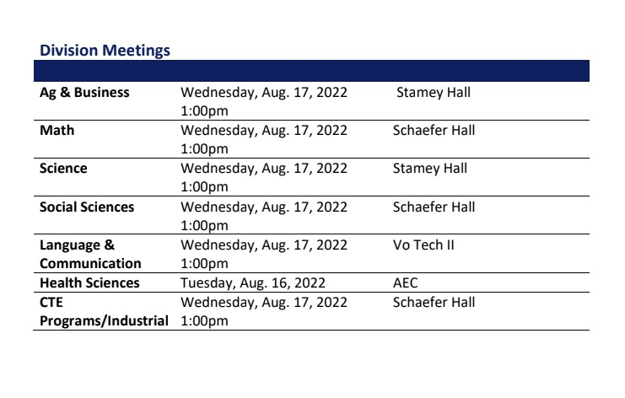

Slide 18
Cisco College: Gateway to Higher Education
Celebrating Milestones and Preparing for the Road Ahead

